Slide 1
CMSC 449 Malware Analysis
Lecture 20
Malware Data Science

Slide 2
Malware Data Science
Hundreds of thousands of unique, new malware samples daily
Impossible for human analysts to investigate every file
Need to rely on automation and data science!
Can we automate common analysis tasks?
Can we enhance threat hunting, malware classification, etc.?

Slide 3
Public Malware Datasets
EMBER2018 Dataset - PE metadata extracted from ~500,000 malicious files and ~500,000 benign files
https://github.com/elastic/ember
SOREL-20M Dataset - PE Metadata from ~10M benign files and ~10M disarmed malware samples from 11 categories
https://github.com/sophos/SOREL-20M
MOTIF Dataset - 3,095 malicious PE files from 454 malware family families with ground truth labels
https://github.com/boozallen/MOTIF/

Slide 4
Automating Malware Analysis

Slide 5
Malware Analysis Pipeline
Most large malware analysis shops have a pipeline which automatically processes malware
Newly-ingested files
Re-processing older files
Basic static analysis
Basic dynamic analysis
Malware signatures (YARA, Snort, AV)

Slide 6
Automating Basic Static Analysis
Extract file metadata
Python libraries such as pefile, lief for extracting PE metadata
Compute similarity hashes
SSDEEP
TLSH
LZJD / BWMD
Compute metadata hashes
pehash
imphash

Slide 7
Side Note: Automating Disassembly
Can automate many advanced static analysis tasks
Too slow to apply to every malware sample though
Capstone library for Python is an excellent linear disassembler
Most modern disassemblers/decompilers (including IDA Pro, Ghidra, Binary Ninja) support plugins
Can use these for automating many advanced static analysis tasks

Slide 8
Automating Basic Dynamic Analysis
Automated sandboxes such as Cuckoo and DRAKVUF can be self-hosted and used for identifying malware behavior
Generate report about the malware’s actions:
Process tree
Created files
Network traffic
Configuration changes

Slide 9
Malware Signatures
Many malware analysis shops have a collection of in-house antivirus products
May also maintain other large collections of signatures:
YARA rules - based on file contents
Snort rules - based on network traffic
The yara-python library lets YARA be used programmatically

Slide 10
Malware Data Science Problems

Slide 11
Threat Hunting
Goal is to identify malware of interest, usually related to a set of known IOCs
Often investigating a malware family, campaign, or threat group
File similarity metrics, metadata hashing
Identifying files which contact the same IPs / domain names
Lots of nearest-neighbor lookup research in this area!

Slide 12
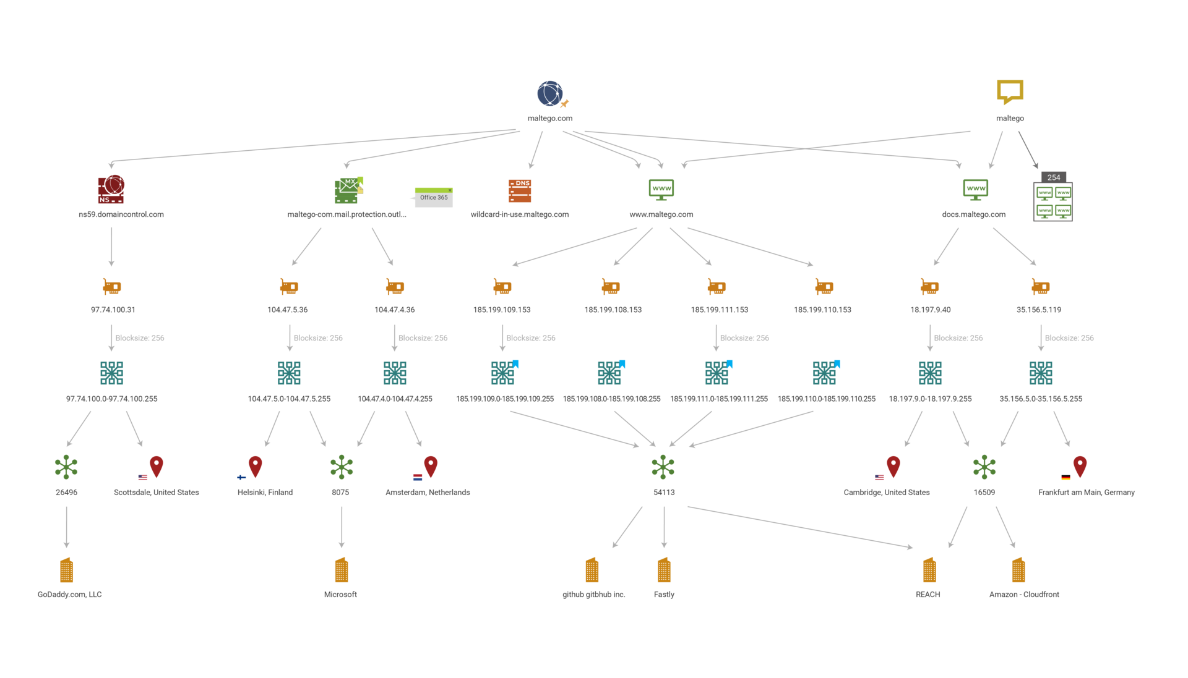
Threat Hunting with Maltego
Threat hunting tool which can be used to pivot from known IOCs to related ones
Generates a graph showing how IOCs are related

Slide 13
Malware Featurization
A feature vector is the standard input for most machine learning algorithms (nearest-neighbor lookup, clustering, classification, outlier detection etc.)
Essentially a list of numbers which somehow describe the attributes of a data point
< 10, -2, 3, 7, 0 >
Each number in the feature vector describes a specific attribute of the data point

Slide 14
Malware Featurization
How do we best represent malware as a feature vector?
EMBER vector - Based on metadata from PE files
Features include byte frequency, metadata from PE headers, strings, imports, resources, etc.
Vector contains 2,351 features
BWMD vector - Based on the Burrows-Wheeler Transform
Converts any sequence of bytes into a fixed-length vector
Vector contains 65,536 features

Slide 15
Malware Clustering
Clustering: Identify groups of similar malware samples
Usually need to convert malware into feature vectors first!
Or have a method for computing similarity between two files
Many different clustering algorithms, depending on your situation and goals
Density-based and hierarchical clustering algorithms work best
But may run slowly on large datasets

Slide 16
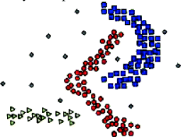
Density-Based Clustering
Assume that malware data tends to form lots of small, dense clusters (each cluster being a malware family)
Dense groups and their neigbors become a cluster
Algorithms such as DBSCAN and OPTICS often work well!

Slide 17
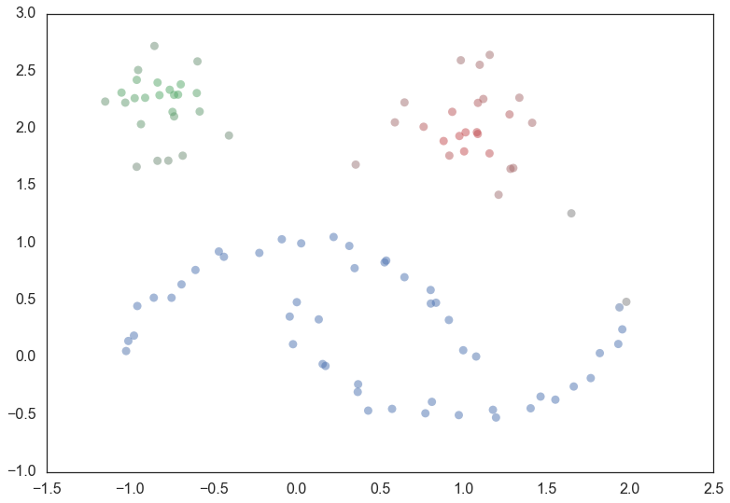
Hierarchical Clustering
Idea is to form a “hierarchy” of data points, iteratively grouping the nest most similar points
Algorithms such as Hierarchical Agglomerative Clustering (HAC) and HDBSCAN are good!
https://hdbscan.readthedocs.io/en/latest/how_hdbscan_works.html

Slide 18
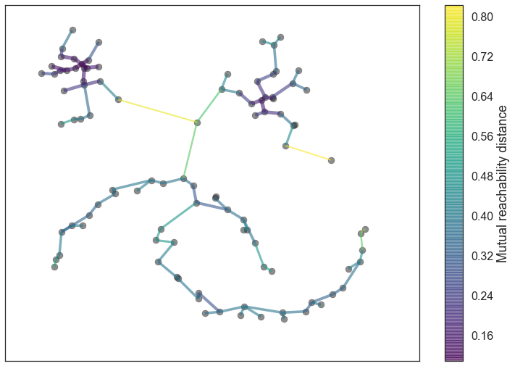
Hierarchical Clustering
Idea is to form a “hierarchy” of data points, iteratively grouping the nest most similar points
Algorithms such as Hierarchical Agglomerative Clustering (HAC) and HDBSCAN are good!
https://hdbscan.readthedocs.io/en/latest/how_hdbscan_works.html

Slide 19
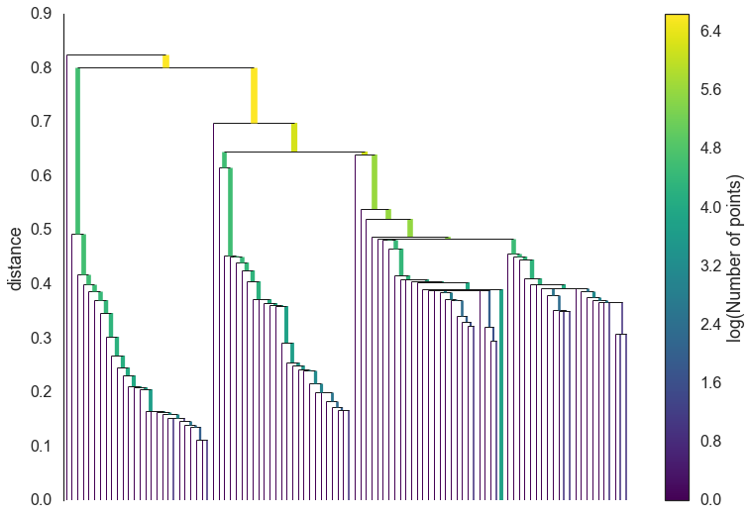
Hierarchical Clustering
Idea is to form a “hierarchy” of data points, iteratively grouping the nest most similar points
Algorithms such as Hierarchical Agglomerative Clustering (HAC) and HDBSCAN are good!
https://hdbscan.readthedocs.io/en/latest/how_hdbscan_works.html

Slide 20
Hierarchical Clustering
Idea is to form a “hierarchy” of data points, iteratively grouping the nest most similar points
Algorithms such as Hierarchical Agglomerative Clustering (HAC) and HDBSCAN are good!
https://hdbscan.readthedocs.io/en/latest/how_hdbscan_works.html

Slide 21
Malware Classification
Classification: Task of assigning a class to a data point
Malware Detection: Classify file as benign/malicious
Category Classification: Classify file by behavior category (e.g. ransomware, keylogger, etc.)
Family classification: Classify file by malware family

Slide 22
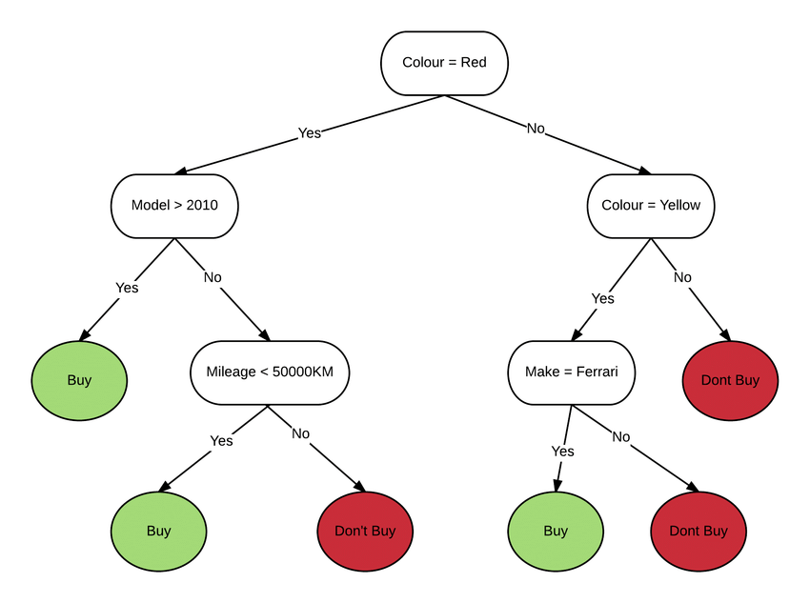
Decision Tree Classifiers
Decision Tree - simple classification algorithm that maps combinations of features to a class outcome
In the figure, the result for red cars newer than 2010 is the “buy” class

Slide 23
Decision Tree-Based Ensemble Classifiers
Ensemble: Powerful machine learning technique where a collection of classifiers (often decision trees) vote on a class
Algorithms like Random Forests, XGBoost, and LightGBM are extremely accurate for malware detection
Usually trained on EMBER feature vectors

Slide 24
Deep Learning-Based Malware Classifiers
Lots of research using neural networks and deep learning for malware classification
MalConv and MalConv2 are leading models
Treat malware as a large sequence of bytes
Apply 1-D convolution to extract spatial relationships from data
Features are learned through convolution!

